Slide 1

The Child with a Genitourinary Condition Chapter 29 Niomi Quinteros BSN, RN

Slide 2
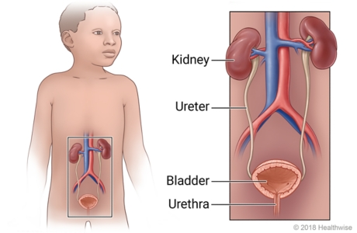
Development of the GU System
Consists of
2 kidneys
2 ureters
Urinary bladder
Urethra
Function
To rid the body of waste products
To maintain body fluid homeostasis

Slide 3
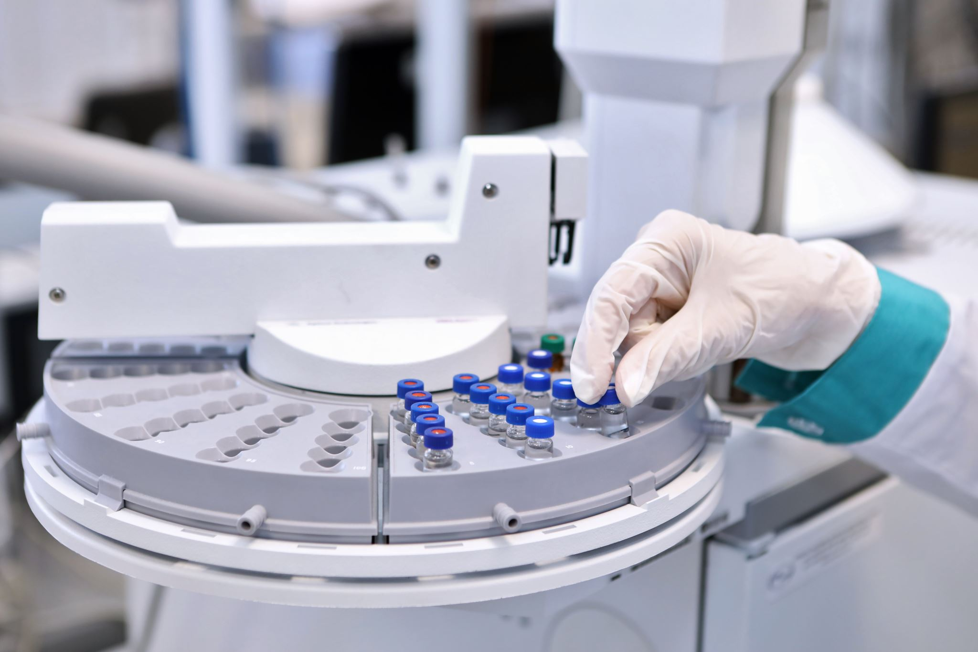
Assessment of Urinary Function
Diagnostic Studies
UA
Urine culture
IVP
CT Scan
VCUG Scan
Laboratory testing

Slide 4
Common Terminology
Dysuria
Frequency
Urgency
Nocturia
Enuresis
Polyuria
Oliguria

Slide 5
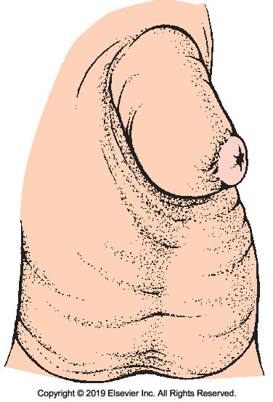
Phimosis
Narrowing or stenosis of the opening of the foreskin
Prevents foreskin from retracting
Disappears by age 3
Circumcision can correct the condition

Slide 6
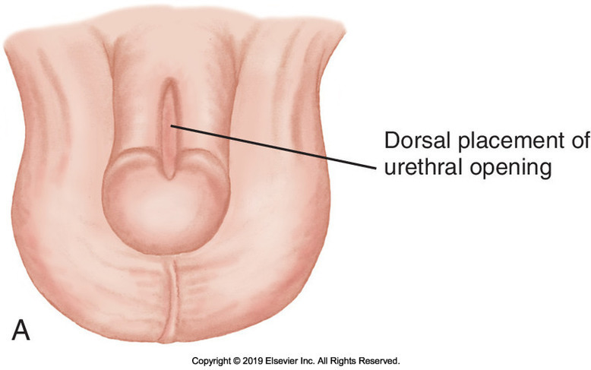
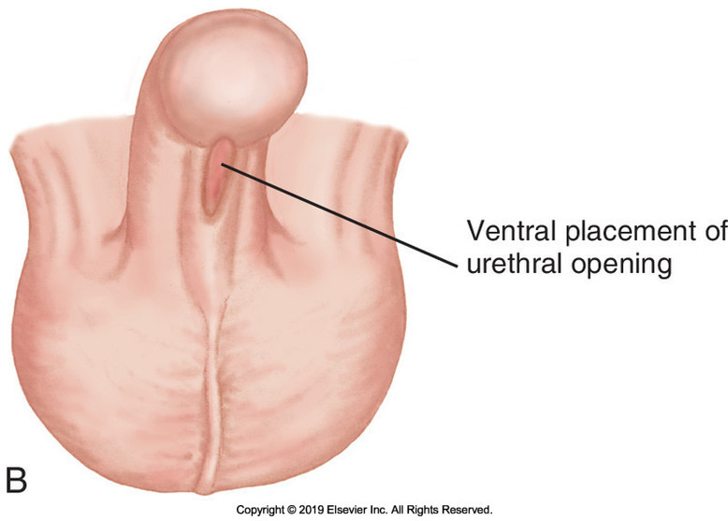
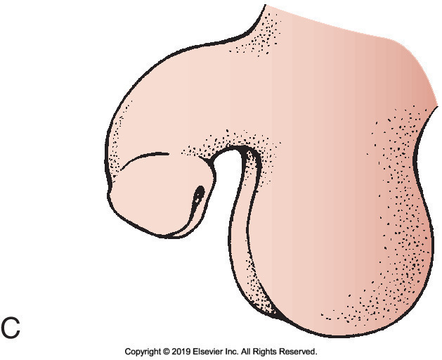
Hypospadias/Epispadias
Hypospadias: Congenital defect in which the urinary meatus is located on the lower portion of the shaft
May be accompanied by chordee, a downward curvature of the penis from a fibrous band of tissue
Epispadias: Urinary meatus is on the upper surface of the penis

Slide 7
Treatment and Nursing Care
Surgery
Performed at 6-12 months of age
-Routine circumcision is avoided because foreskin may be useful in the repair
Postop
Prevent infection
Minimal restricted activity
I&O’s
May have urinary catheter
Medications for bladder spasms
Instruct parents to keep from straddling infant to avoid pressure on the operative site

Slide 8
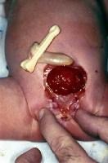
Exstrophy of the Bladder
Lower portion of abdominal wall and anterior wall of bladder are missing.
Urinary bladder lies open and exposed on abdomen.
Cover with plastic shield or protective dressing

Slide 9
Obstructive Uropathy
Obstruction of the urinary system
Priorities of Nursing Care:
Providing emotional support
Preventing infection
Age-Specific Issues:
Toilet training (toddler)
Distorted body image (school-age)
Lowered self-esteem (adolescent)
Surgical Intervention
Ureterostomy
Ileal conduit
Nephrostomy
Suprapubic catheter
Vesicostomy

Slide 10
Acute Urinary Tract Infection (UTI)
Infants:
Diaper rash
Foul-smelling urine
Frequent urination
Weight loss
Fever
Failure to thrive
Older Child:
Urinary frequency
Pain during urination
Onset of bedwetting
Abdominal pain
Hematuria
Treatment:
Broad-spectrum antibiotics or Sulfonamides (Penicillin or Bactrim)
Teaching of family
Treatment of underlying defect (if indicated)

Slide 11
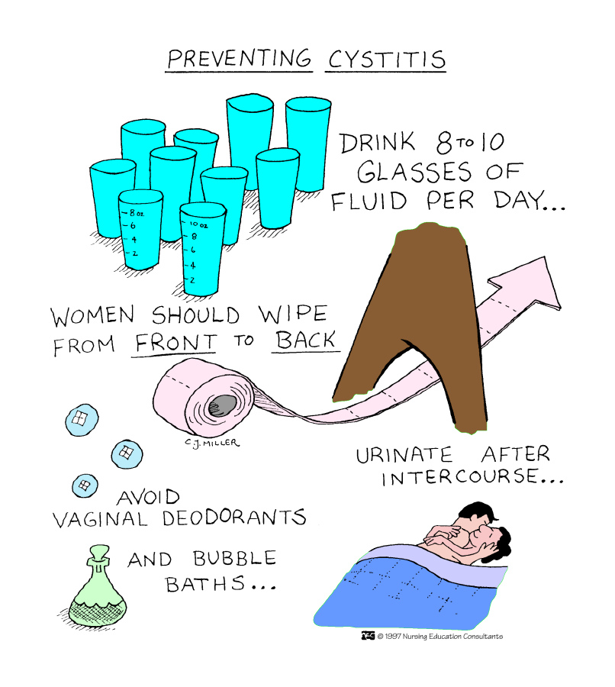

Slide 12
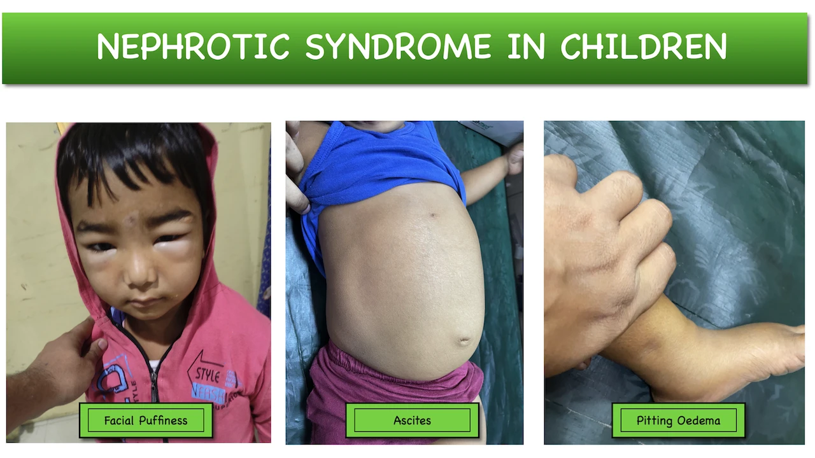
Nephrotic Syndrome Glomerular Disease
Symptoms:
Edema in the lower legs, feet, abdomen, hands, face, or other parts of the body
Weight gain
Pallor
Irritability/listlessness
Poor appetite
Increase albumin (protein) in urine
Foamy urine

Slide 13
Nephrotic Syndrome Glomerular Disease
Nursing Considerations:
Well-balanced diet
Provide good skin care; frequent positioning: Q2H
Strict I/O; abdominal girth daily
May need a diuretic
Prevent from infections
May need an antibiotic
Patient/family teaching
Treatment:
Minimizing edema
Steroids or Immunosuppressive therapy
Monitor for infection
Abdominal paracentesis; thoracentesis

Slide 14
Acute Glomerulonephritis (AGN)/Bright’s Disease
Manifestations:
Urine is brown or bloody
Periorbital edema
Fever, headache
Decreased urine output
Diarrhea, vomiting
Hypertension
Treatment/Nursing Considerations:
Penicillin
Decreased activity
Strict I/O
Urine labs
Caused by an allergic reaction to Group A beta-hemolytic streptococcal infection

Slide 15
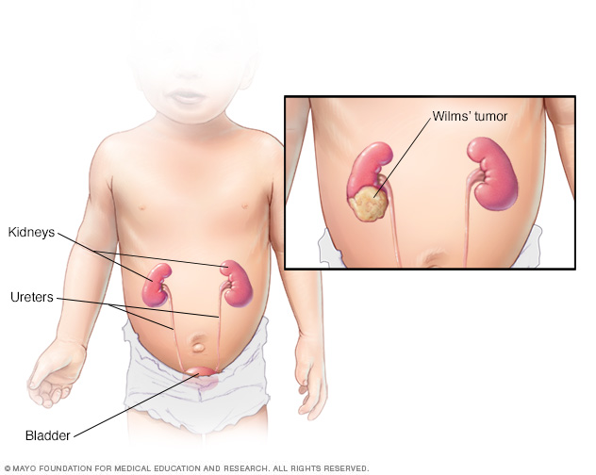
Wilm’s tumor (Nephroblastoma)
Symptoms:
Early- none
Late- swelling of abdomen
Treatment/nursing considerations
Surgery
Radiation/chemo
Comfort measures
No palpating of abdomen

Slide 16
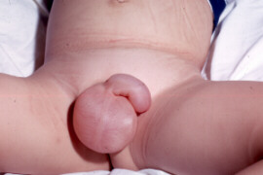
Hydrocele
Excessive fluid in the scrotal sac. (May or may not req. surgery)
Many times, corrects itself by age 1 year old
Surgery for chronic hydrocele, lasting more than 1 year

Slide 17
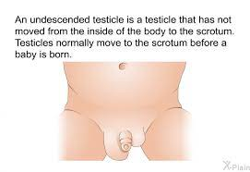
Cryptorchidism
One or both testes fail to lower into the scrotum
Possible sterility
Torsion
Orchiopexy
Prevent infection

Slide 18
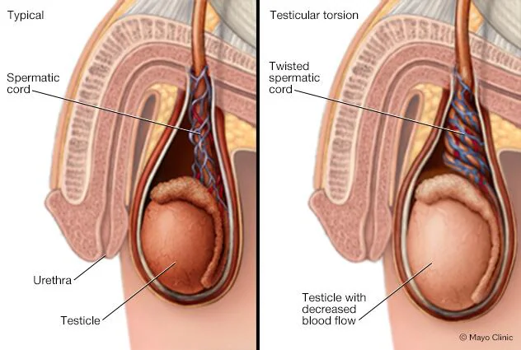
Torsion
Symptoms
Sudden, severe pain in the scrotum
Swelling or lump in the scrotal sac
Abdominal pain
Nausea and vomiting

